Slide 1
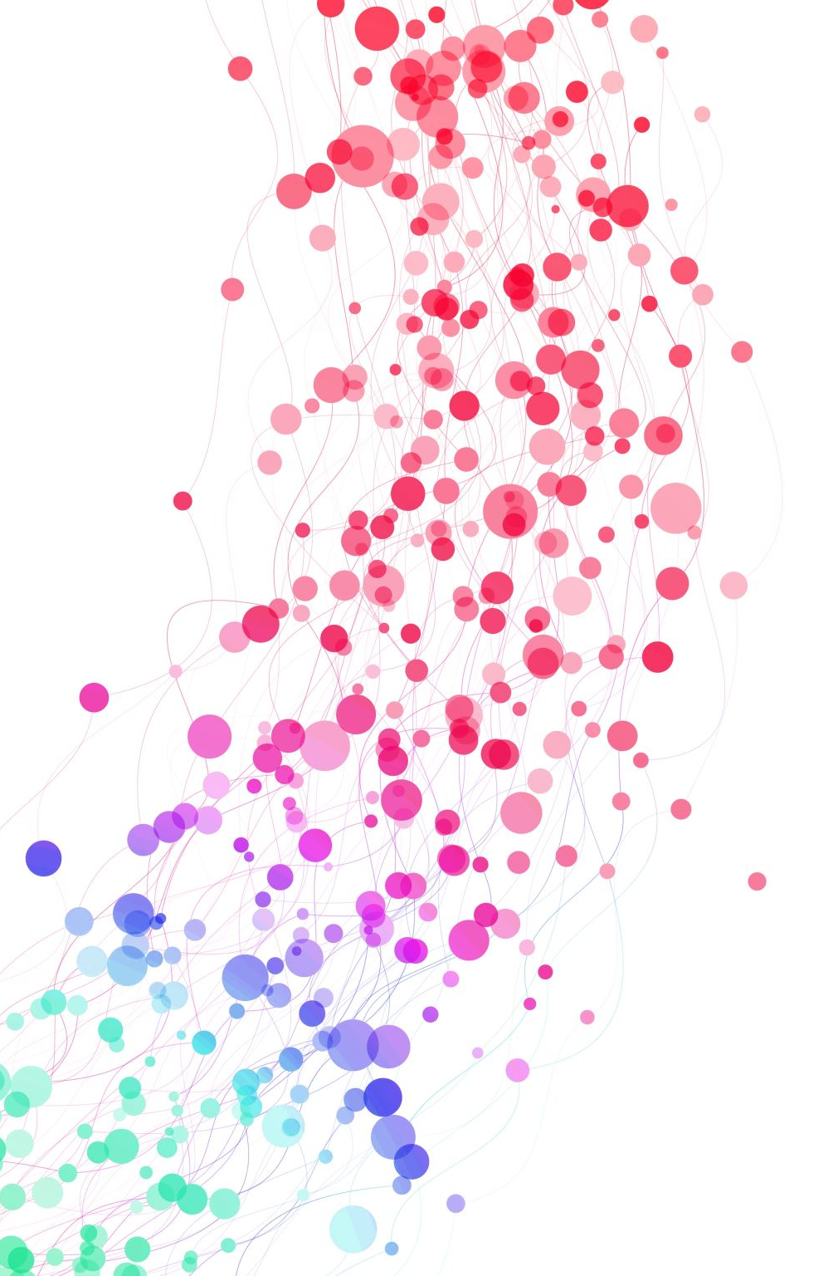
Finding Opportunities for OCM with AI
Presented By:
Craig Bunce
Hemanth Varma
Praveen Pandey
Xinyi Luo

Slide 2
Goals for Today (Revisit)
A quick recap of what we discussed earlier
Align on deliverables for OCM webcrawler

Slide 3
Agenda
Data Understanding– IMDB Data
Data Understanding– RFP Data
Model results
Conclusion

Slide 4

IMDB Dataset
50K records and 2 columns; review and sentiments
It has 25K positive and negative reviews from the users.
Sentiments are equivalent to yes/no tag from the web crawler.

Slide 5

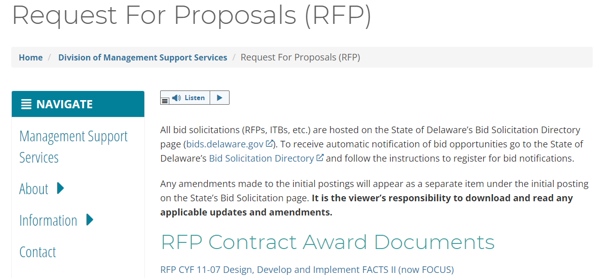
Standard RFP Dataset
Source: first paragraph of main body on websites through urls.(sample sites)
Direct RFP Example (27 pages):
Transfer Site Example (27 pages):
Testcases which are not new for models (5 pages): 3 direct RFPs + 2 transfer sites

Slide 6
Selected NLP Model: BERT
Background: BERT was a breakthrough in NLP developed and released by Google in 2018.
How powerful is BERT: In October 2019, Google announced a 10% boost in search results by applying the BERT algorithm to its search engine.
Why BERT is chosen to accomplish this task:
Accredited NLP model, with pre-trained generalized ability.
Understand sentences with the order of words(bidirectionally trained).
It allows fine-tuning to fit specific task requirements.
BERT in this Project:
Learn from the valid RFPs. (narrower range, specialized target recognition than Google Search Engine)
Relatively shorter training time.(comparing to other generalized AI)
Google search learns from terms, our model learns from articles. (The longer the texts, the more information carried)
Notes:
Make bullet 1 more relatable to Earl (or remove it)
Take the general model and make it specific to OCM
Need some image on the slide
If BERT

Slide 7
BERT Result
Train on two datasets: IMDB reviews and standard RFP
IMDB Review:
Large Dataset (50000 records)
 | Positive Review | Negative Review
Text | Having seen most of Ringo Lam's films, I can say that this is his best film to date, and the most unusual... | The movie was okish...This film has got to be the epitome of terrible writing and should be a classroom example of 'what not to do' when writing a screenplay.
Metaphors, harder to understand by machines
BERT Performance:
Training time: ~2.5 hours, but only need train once
Final accuracy: 89.68%
9 out of 10 reviews are predicted correctly

Slide 8
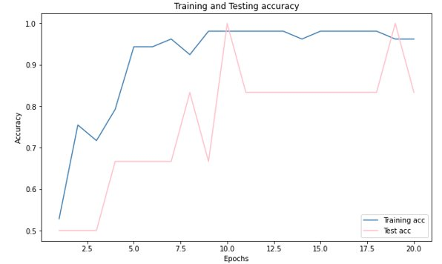
BERT on Standard RFPs
Standard RFPs:
Small Dataset (60 records)
Final Accuracy:
Known data: 96.23% accuracy
Unknow data: 83.33% accuracy
(only 1 transfer site in 5 "predict-direct" search results)
Train time: ~5 mins
More cases,
More accurate
Challenge
BERT Learn Fast!!

Slide 9
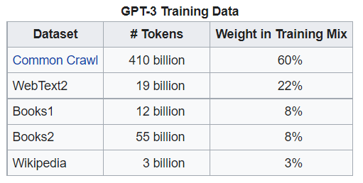
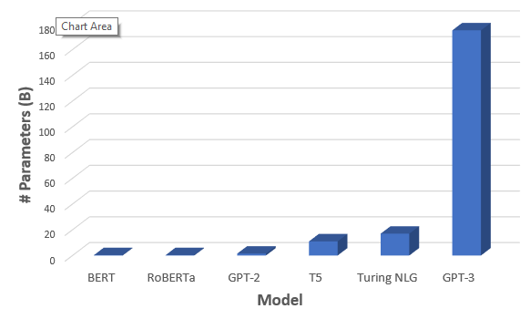
Selected Model: GPT-3
Background: Third of its kind. Released June 11th, 2020, An autoregressive Language Model to generate human-like texts.
How powerful GPT-3 is: It is trained on billions of data available over the internet. GPT-3 has seen it all.
Why GPT-3:
Considered to be the best generalized model available in the market.
Easy to train, Playground etc.
Efficient results compared to other models.

Slide 10
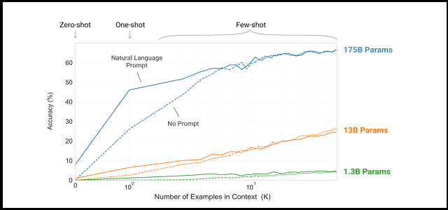
GPT-3 Results
Pros | Cons
Easy to understand and use | Paid Service
Different engines available to use from
Number of examples available
High accuracy with less training

Slide 11
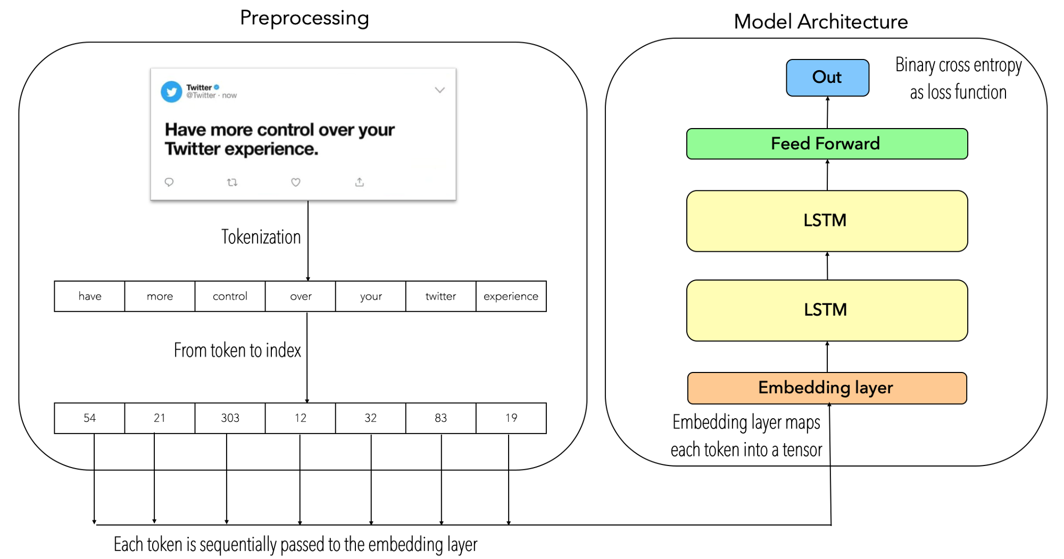
Selected Model: LSTM
What is LSTM: Long Short-Term Memory model is an artificial neural network model which is well suited for making text classifications.
Background: It is developed on the principle of Recurrent Neural Networks and allows memorize high frequency words
How powerful is LSTM: They are very powerful in sequence prediction problems because they're able to store past information
Why do we use LSTM for this task: LSTM can handle the information in memory for the long period of time as compared to RNN
Limitations of LSTM:
It take longer to train
It require more memory to train
LSTMs are easy to overfit
Notes:
Change

Slide 12
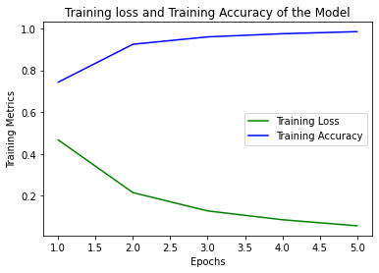
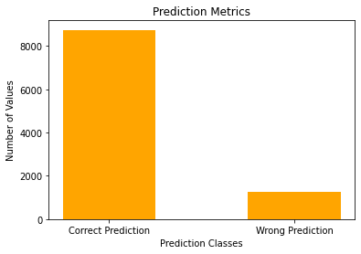
LSTM on IMDB Dataset
Pros | Cons
Provides accurate results based on the data provided | Consumes more time on large amount of data
Can adjust the model based on requirement | Requires more memory and information to train
Can retrain model periodically for better results
Metrics | Scores
Training Time | ~ 5 mins
Train Accuracy | 98%
Test Accuracy | 90%

Slide 13
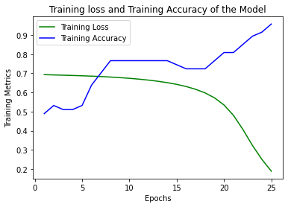
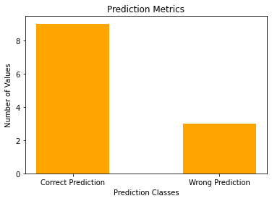
LSTM on Standard RFP Dataset
Metrics | Scores
Training Time | ~ 5 mins
Train Accuracy | 95%
Test Accuracy | 75%

Slide 14
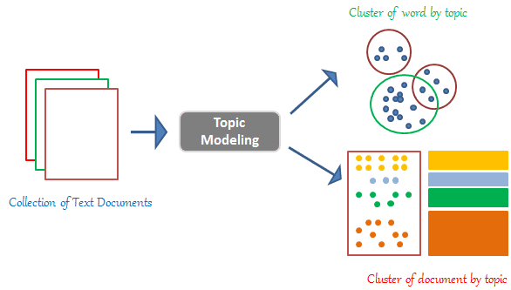
Selected Model: LDA
What is LDA: Latent Dirichlet Allocation (LDA) is a method for analyzing large electronic archives
Background: LDA categorizes the topic(s) in each document
How powerful is LDA: LDA can quickly scan websites (documents) and determine the key topics
Why do we use LDA for this task: It is fast and intuitive. It will help find more docs that we care about in the specified categories
Limitations of LDA: Some topics can get combined. Tuning is important!
Notes:
Craig Presents

Slide 15
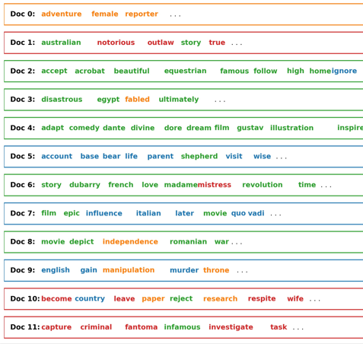
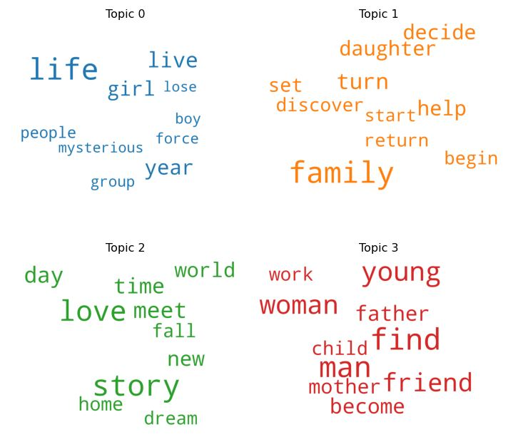
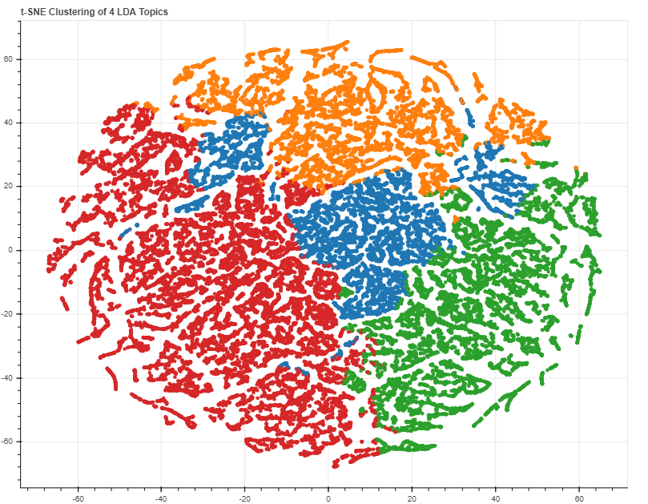
LDA Results with IMDB Dataset
1. Prep Data
2. Model Topics
3. Analyze Output
Notes:
Craig Presents
The LDA process begins with data prep. As previously mentioned we used an IMDB movie dataset.
1. As you can see from the first visual, first we arrange all the web sites into a group (called documents in this case) and pick out all the keywords.
2. Next, in image 2 we run the LDA model on the topics using the documents as input. What we get back is a group of keywords. Now the model knows whenever it sees a keyword (or a word semantically related to the keyword) it classifies the document under that particular topic. Note: we could have chose any number of topics, in this case we chose 4.
3. Finally, in step 3, we analyze the output. For the OCM team, this means we take a look at each of the topics and decide which ones to keep and which ones we want to filter out. For example news articles may include words such as source, reported, people, etc. Or a website offering services might have topic keywords such as sale, sign-up, solution, and pricing. With that in mind we can tag (annotate) each of the websites in the topic as "noise" or "actual Grant/RFP".
We can use this model in 2 ways:
1. To speed up the data labeling/annotation process by filtering out all of the noise (I.e. news articles and service sites)
2. To clean the list of websites from the web-crawler so you are only viewing sites related to actual Grants/RFPs
Drawbacks: Because we ran this LDA model unsupervised its possible some of the documents will be misclassified. We will need to do additional model tuning and deeper analysis of the percent contribution from each keyword/topic on your dataset.

Slide 16

Conclusion
4 Models with insights for each:
BERT | GPT-3 | LSTM | LDA
Generalized AI Model Less build effort Shorter running time than other pre-trained AI | Generalized AI Model Easy to train, and get accurate results | Specific AI Model Requires more data Provides accurate predictions based on the data provided | Specific AI Model Fast and Intuitive Topic Modeling
Notes:
Results may vary based on available training data

Slide 17

This Photo by Unknown author is licensed under CC BY-NC.

Slide 18
References
Where did NLP Come From?
GPT-3 Powers the Next Generation of Apps. (2021). Retrieved 27 October 2021, from https://openai.com/blog/gpt-3-apps/
IMDB Dataset of 50K Movie Reviews. (2021). Retrieved 15 December 2021, from https://www.kaggle.com/lakshmi25npathi/imdb-dataset-of-50k-movie-reviews
LDA Image
Topic modelling with LDA -A hands-on introduction. Analytics Vidhya. (2021, August 27). Retrieved November 8, 2021, from https://www.analyticsvidhya.com/blog/2021/07/topic-modelling-with-lda-a-hands-on-introduction/.
BERT Model
Vaswani, A. (2017). Attention Is All You Need. [1706.03762](arxiv.org), from https://arxiv.org/abs/1706.03762
Alammar, J. (2018). The Illustrated Transformer-Visualizing machine learning one concept at a time. (jalammar.github.io), from https://jalammar.github.io/illustrated-transformer/
Hinton, G. (2015). Distilling the Knowledge in a Neural Network, from https://arxiv.org/pdf/1503.02531.pdf
LSTM Model
Wikimedia Foundation. (2021, November 29). Long short-term memory. Wikipedia. Retrieved December 12, 2021, from https://en.wikipedia.org/wiki/Long_short-term_memory
Brownlee, J. (2017, May 24). A Gentle Introduction to Long Short-Term Memory Networks by the Experts. Machine Learning Mastery. Retrieved December 12, 2021, from https://machinelearningmastery.com/gentle-introduction-long-short-term-memory-networks-experts/
LDA
Prabhakaran, S. (2021, November 14). Topic modeling visualization - how to present results of LDA Model?: ML+. Machine Learning Plus. Retrieved December 13, 2021, from https://www.machinelearningplus.com/nlp/topic-modeling-visualization-how-to-present-results-lda-models/.

